Slide 1
Azure Machine Learning on Databricks
Mithun Prasad, PhD
miprasad@microsoft.com

Slide 2
Agenda
Machine Learning on Azure
Custom AI
Azure Databricks (ADB)
Infrastructure (DSVMs and Managed Compute)
AutoML
Flexible and Support for Open Source Frameworks
Deployment

Slide 3






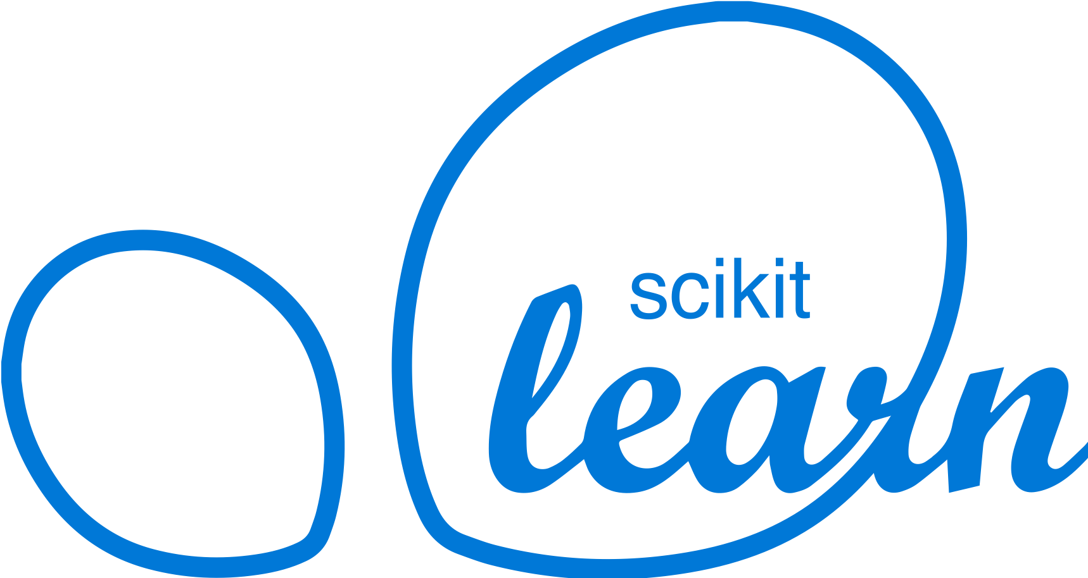

Machine Learning on Azure
Domain Specific Pretrained Models
To reduce time to market
…
Vision
Speech
Language
Search
Familiar Data Science Tools
To simplify model development
PyCharm
Jupyter
Visual Studio Code
Command line
Popular Frameworks
To build machine learning and deep learning solutions
PyTorch
TensorFlow
Scikit-Learn
ONNX
Productive Services
To empower data science and development teams
Azure Databricks
Azure Machine Learning
Machine Learning VMs
Powerful Infrastructure
To accelerate deep learning
CPU
GPU
FPGA
From the Intelligent Cloud to the Intelligent Edge

Slide 4
Custom AI

Slide 5
Data Science process
1. define problem
2. acquire + process data
6. deploy
3. design model architecture
5. test/evaluate
4. train model
a. initialize
y =Wx + b
b. feed in data
e. update weights
d. optimize metric
c. calculate metric
loss = |desired – actual outcome|

Slide 6



Productive services Empower data science and development teams
Integrated data science & data engineering teams
Desktop solutions not adequate
Need a unified big data & machine learning solution
Individual data scientists
Desktop solutions adequate
Need cloud for sporadic compute needs
+
Azure Databricks
Azure Machine Learning service
Machine Learning VMs
Notes:
We realize that companies are at different stages of building data science teams.
From a sales perspective, we would like you to focus on companies that are building end to end big data and machine learning solutions as this where you will drive maximum amount of Azure consumption.
For these customers, we recommend starting with Azure Databricks and enhancing the ML experience with Azure Machine Learning.
Now we also realize that a good number of projects that are not done on big data or by big integrated teams.
For these customers, we have a set of Machine Learning VMs that are pre-provisioned with popular open source tools and packages. These are essentially desktops in the cloud that enable data scientists to quickly get up and running for their projects.
Let’s look at how we use Azure Databricks and Azure ML together.

Slide 7
Azure Machine Learning service
Bring AI to everyone with an end-to-end, scalable, trusted platform
Built with your needs in mind
Boost your data science productivity
Automated machine learning
Managed compute
Increase your rate of experimentation
DevOps for machine learning
Simple deployment
Tool agnostic Python SDK
Deploy and manage your models everywhere
Support for open source frameworks
Seamlessly integrated with the Azure Portfolio
Notes:
Azure Machine Learning Services empowers you to bring AI to everyone with an end-to-end, scalable, trusted platform.
Boost your data science productivity
Python pip-installable extensions for Azure Machine Learning that enable data scientists to build and deploy machine learning and deep learning models
Now available for Computer Vision, Text Analytics and Time-Series Forecasting.
Increase your rate of experimentation
Rapidly prototype on your desktop, then easily scale up on virtual machines or scale out using Spark clusters
Proactively manage model performance, identify the best model, and promote it using data-driven insights
Collaborate and share solutions using popular Git repositories.
Deploy and manage your models everywhere
Use Docker containers to deploy models into production faster in the cloud, on-premises, or at the edge
Promote your best performing models into production and retrain them when their performance degrades
Azure Machine Learning Services are built with your needs in mind, providing:
GPU-enabled virtual machines
Low-latency predictions at scale
Integration with popular Python IDEs
Role-based access controls
Model versioning
Automated model retraining
(Optional: other services)
Azure Machine Learning Workbench integrates with ONNX models
Work with your ONNX models from Visual Studio Code Tools for AI.
Build deep learning models and call services straight from your favorite IDE easier with Azure Machine Learning services built right in.
Create a seamless developer experience across desktop, cloud, or at the edge.
AI Toolkit for Azure IoT Edge
MMLSpark is an open-source Spark package that enables you to quickly create powerful, highly-scalable predictive and analytical models for large image and text datasets by using deep learning and data science tools for Apache Spark.
Azure Machine Learning Services seamlessly integrates with the rest of the Azure portfolio.
<Transition>: Azure Machine Learning Services allows you to deploy models to many different production environments.

Slide 8
Azure Databricks

Slide 9

Azure Databricks
Azure Databricks
Collaborative Workspace
IoT / streaming data
Machine learning models
DATA ENGINEER
DATA SCIENTIST
BUSINESS ANALYST
Deploy Production Jobs & Workflows
Cloud storage
BI tools
MULTI-STAGE PIPELINES
JOB SCHEDULER
NOTIFICATION & LOGS
Data warehouses
Optimized Databricks Runtime Engine
Data exports
Hadoop storage
DATABRICKS I/O
APACHE SPARK
SERVERLESS
Rest APIs
Data warehouses
Enhance Productivity
Build on secure & trusted cloud
Scale without limits
Notes:
Databricks, founded by the team that created Apache Spark – unified analytics platform that accelerates innovation by unifying data science, engineering & business.
75% of the code committed to Apache Spark comes from Databricks
Unified Runtime
Create clusters in seconds, dynamically scale them up and down.
They’ve made enhancements to Spark engine to make it 10x faster than open source Spark
Serverless- Auto-configured multi-user cluster, Reliable sharing with fault isolation
Unified Collaboration
Overall – a simple & collaborative environment that enables your entire team to use Spark & interact with your data simultaneously
DE – Improve ETL performance, zero management clusters. Execute production code from within notebooks
DS - For data scientists, easy data exploration in notebooks
Business SME – interactive dashboards empower teams to create dynamic reports
Enterprise Security
Encryption
Fine grained Role-based access control (files, clusters, code, application, dashboard)
Compliance
Rest APIs
DE – DBIO, SPARK, API’s , JOBS
DS – Spark and Serverless, Interactive Data Science
Data Products - Everything
Creators of Spark
Training People
Number of Customers
Ingest
Workflow
Schedule / Run / Monitor
Execute
Troubleshoot
Debug
Production Jobs
---------
Ingest, ETL, Scheduling, Monitoring

Slide 10




Knowing The Various BIG DATA Solutions
CONTROL
EASE OF USE
Azure Databricks
Frictionless & Optimized Spark clusters
Azure HDInsight
Workload optimized, managed clusters
Reduced Administration
Azure Marketplace
HDP | CDH | MapR
BIG DATA ANALYTICS
Any Hadoop technology, any distribution
IaaS Clusters
Managed Clusters
Azure Data Lake Analytics
Azure Data Lake Store
BIG DATA STORAGE
Azure Storage

Slide 11
Data Science Virtual Machine

Slide 12
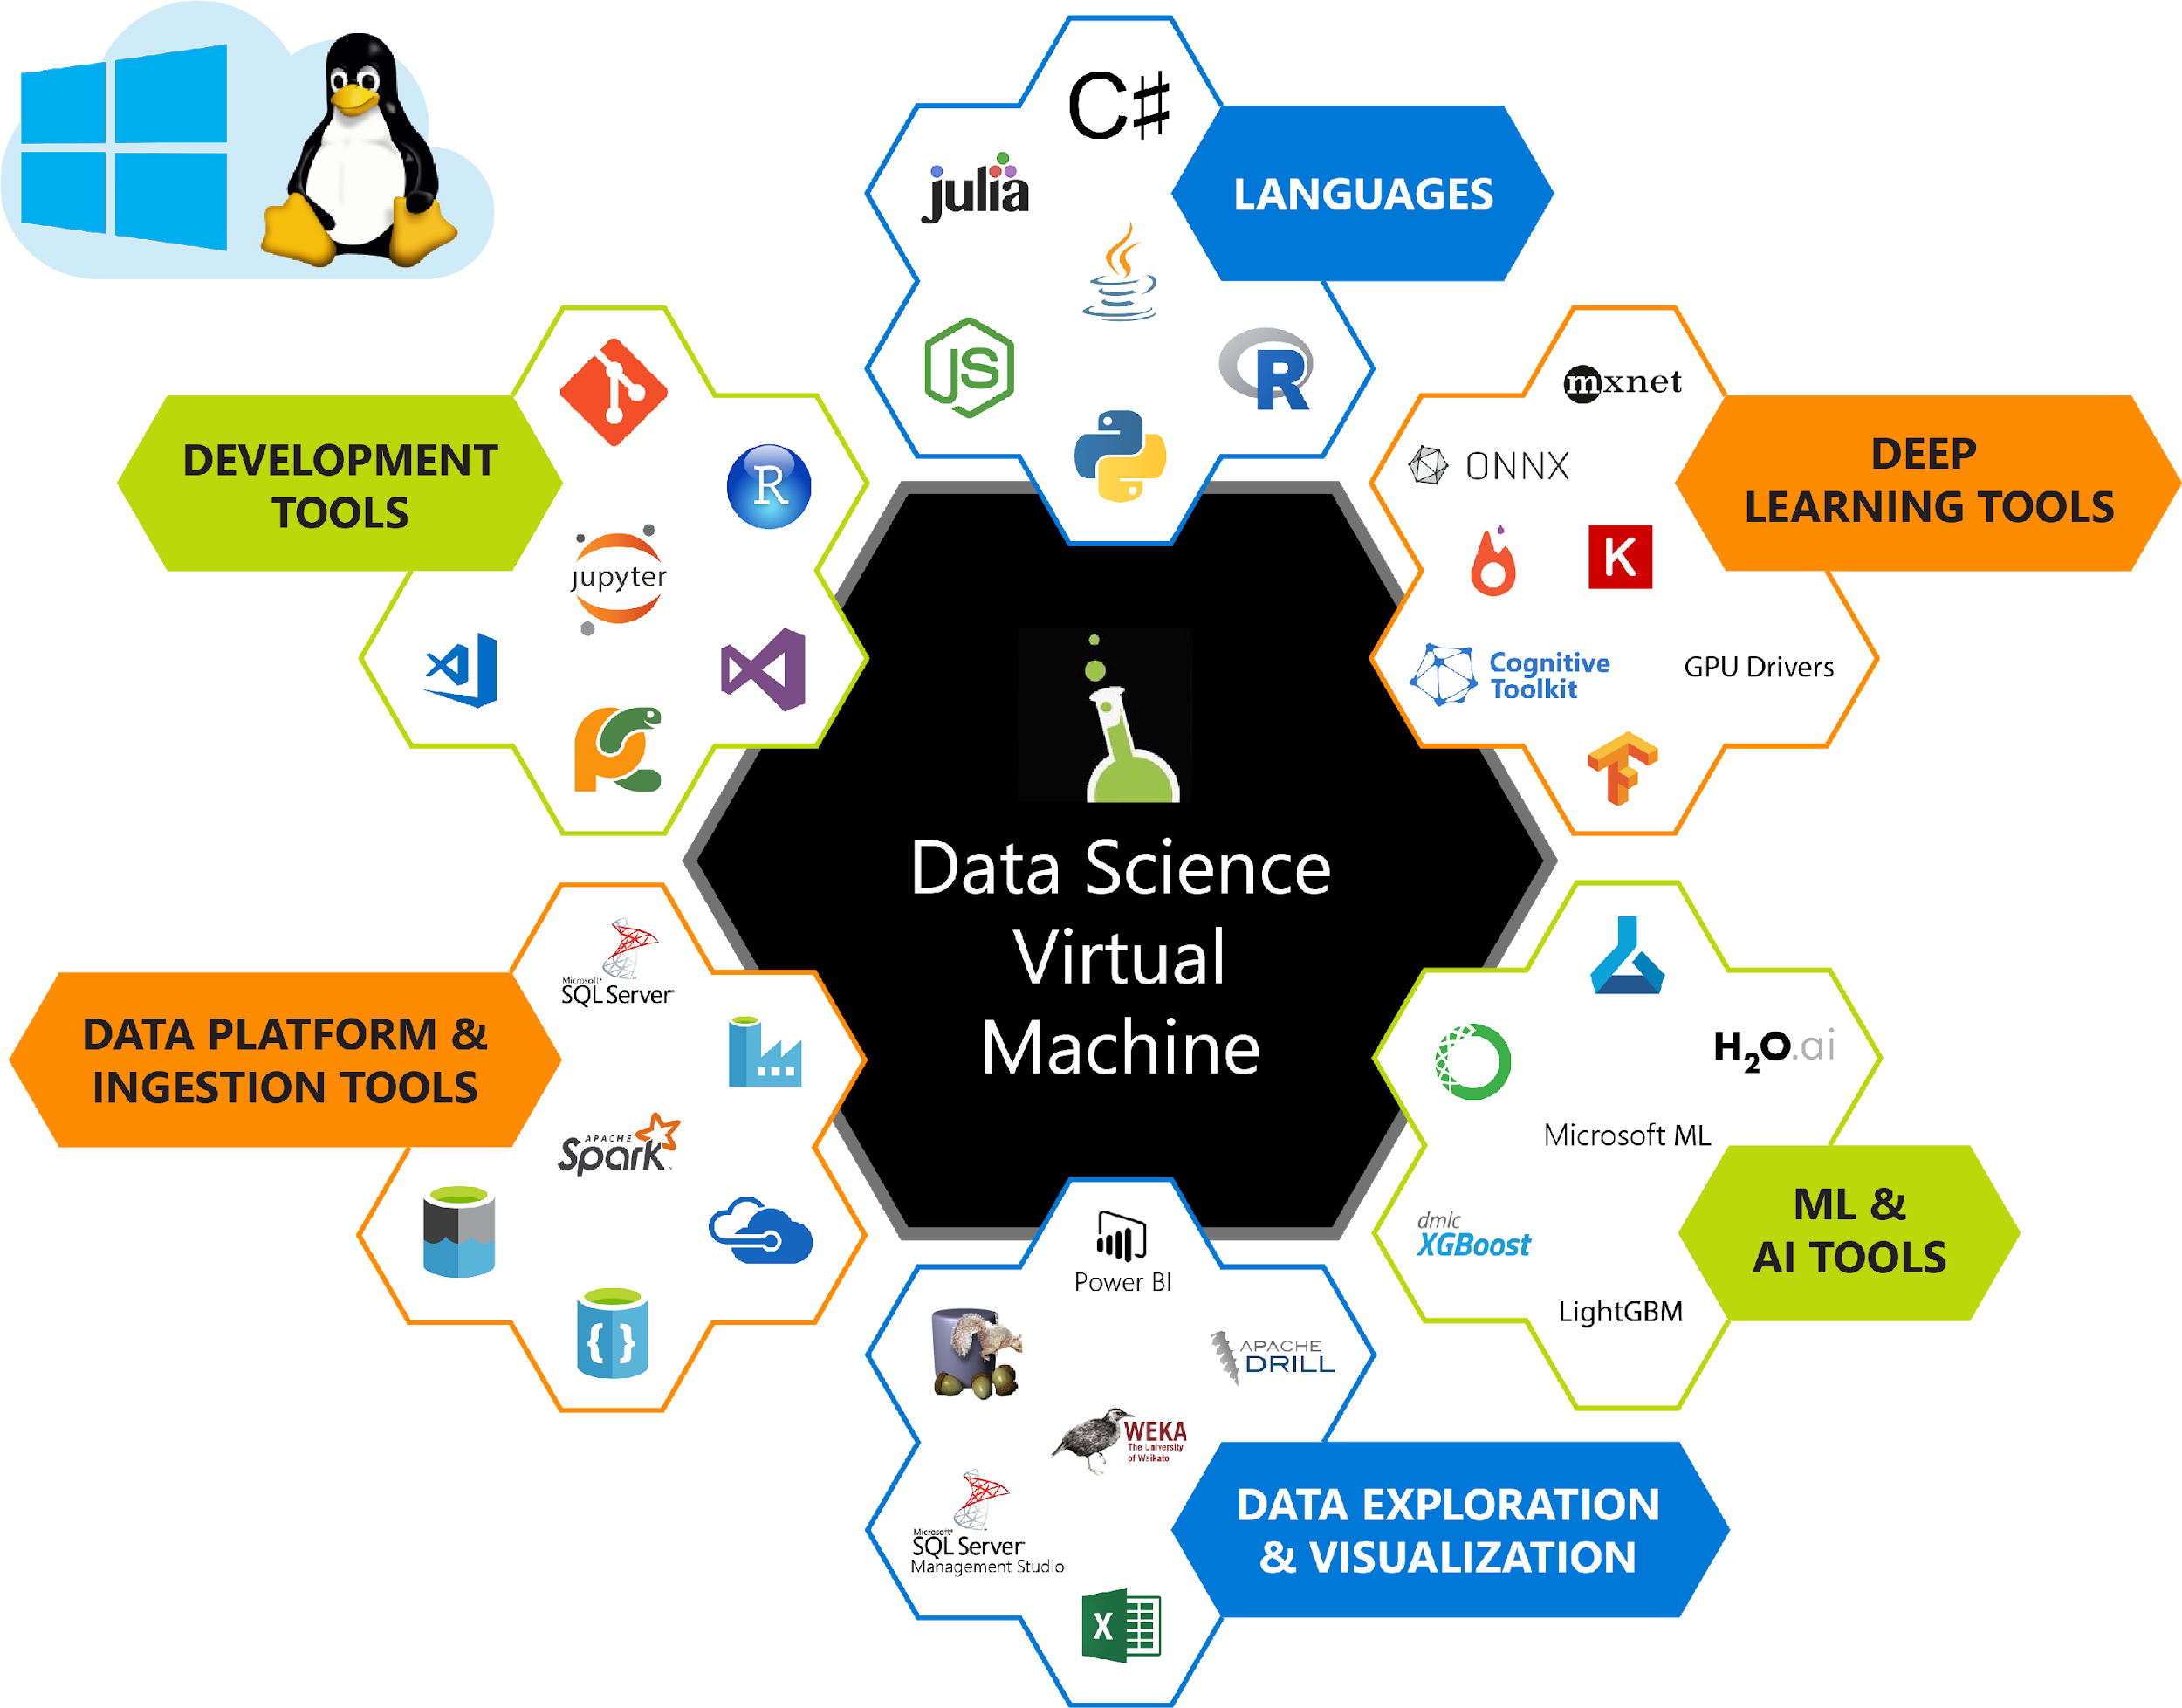
Data Science Virtual Machines (DSVM)
Pre-Configured environments in the cloud for
Data Science & AI Modeling, Development & Deployment.
Samples to get started

Slide 13




Why Data Science VMs?
Elastic analytics desktop in the cloud
Get started quickly on Azure Machine Learning
Pre-setup environment at work and school
Enterprise Ready and globally available

Slide 14
Managed compute

Slide 15
Training infrastructure
Dependencies and Containers
Leverage system-managed AML compute or bring your own compute
Distribute data
Manage and share resources across a workspace
Schedule jobs
Train at cloud scale using a framework of choice
Scale resources
Autoscale resources to only pay while running a job
Provision VM clusters
Use the latest NDv2 series VMs with the NVIDIA V100 GPUs

Slide 16
Automated Machine Learning

Slide 17
Azure Machine Learning Automated machine learning
How much is this car worth?
Notes:
Our approach to ML frameworks is simple.
We give customers the flexibility to choose their deep learning framework, without getting locked one framework.
To help with this we’ve created a community project in partnership with Facebook that allows customers to train in one framework and use another one for inference
Now, let me move to the ML services on Azure

Slide 18
Model Creation Is Typically Time-Consuming
Which features?
Which algorithm?
Which parameters?
Mileage
Condition
Car brand
Year of make
Regulations
…
Gradient Boosted
Nearest Neighbors
SVM
Bayesian Regression
LGBM
…
Parameter 1
Parameter 2
Parameter 3
Parameter 4
…
Mileage
Gradient Boosted
Car brand
Year of make
30%
Model

Slide 19
Model Creation Is Typically Time-Consuming
Which features?
Which algorithm?
Which parameters?
Mileage
Condition
Car brand
Year of make
Regulations
…
Gradient Boosted
Nearest Neighbors
SVM
Bayesian Regression
LGBM
…
Parameter 1
Parameter 2
Parameter 3
Parameter 4
…
Mileage
Gradient Boosted
Condition
Nearest Neighbors
Car brand
Car brand
50%
Year of make
30%
Year of make
Model
Iterate

Slide 20
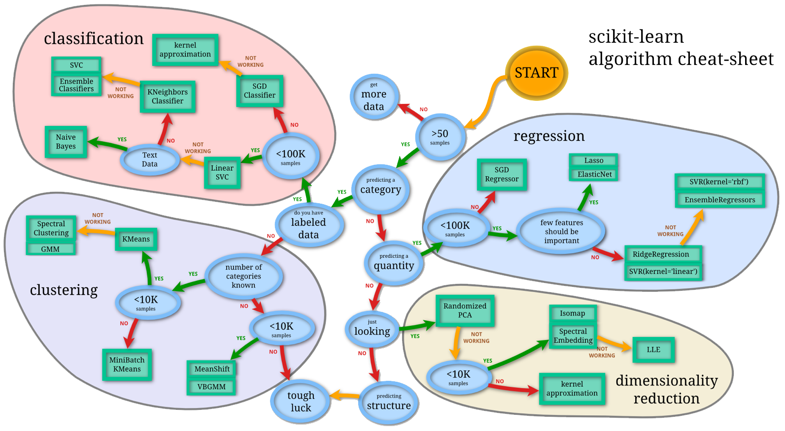
Machine Learning Complexity
Source: http://scikit-learn.org/stable/tutorial/machine_learning_map/index.html

Slide 21

Model Selection & Hyperparameter Tuning
Dataset
Model Training
Infrastructure
Training Algorithm 1
Training Algorithm 2
Model 1
Model 2
Model 3
Model 4
Hyperparameter
Values – config 1
Hyperparameter
Values – config 2
Hyperparameter
Values – config 3
Repetitive & Manual
Hyperparameter
Values – config 4

Slide 22
Introducing Automated Machine Learning
Dataset
Optimization
Metric
Automated ML
ML Model
Constraints
(Time/Cost)
Accessible & Faster

Slide 23
Automated ML Accelerates Model Development
Input
Intelligently test multiple models in parallel
Output
25%
Optimized model
25%
40%
Enter data
70%
25%
40%
70%
95%
Define goals
25%
40%
70%
25%
40%
25%
70%
Apply constraints
40%

Slide 24
Automated Machine Learning Capabilities

Slide 25
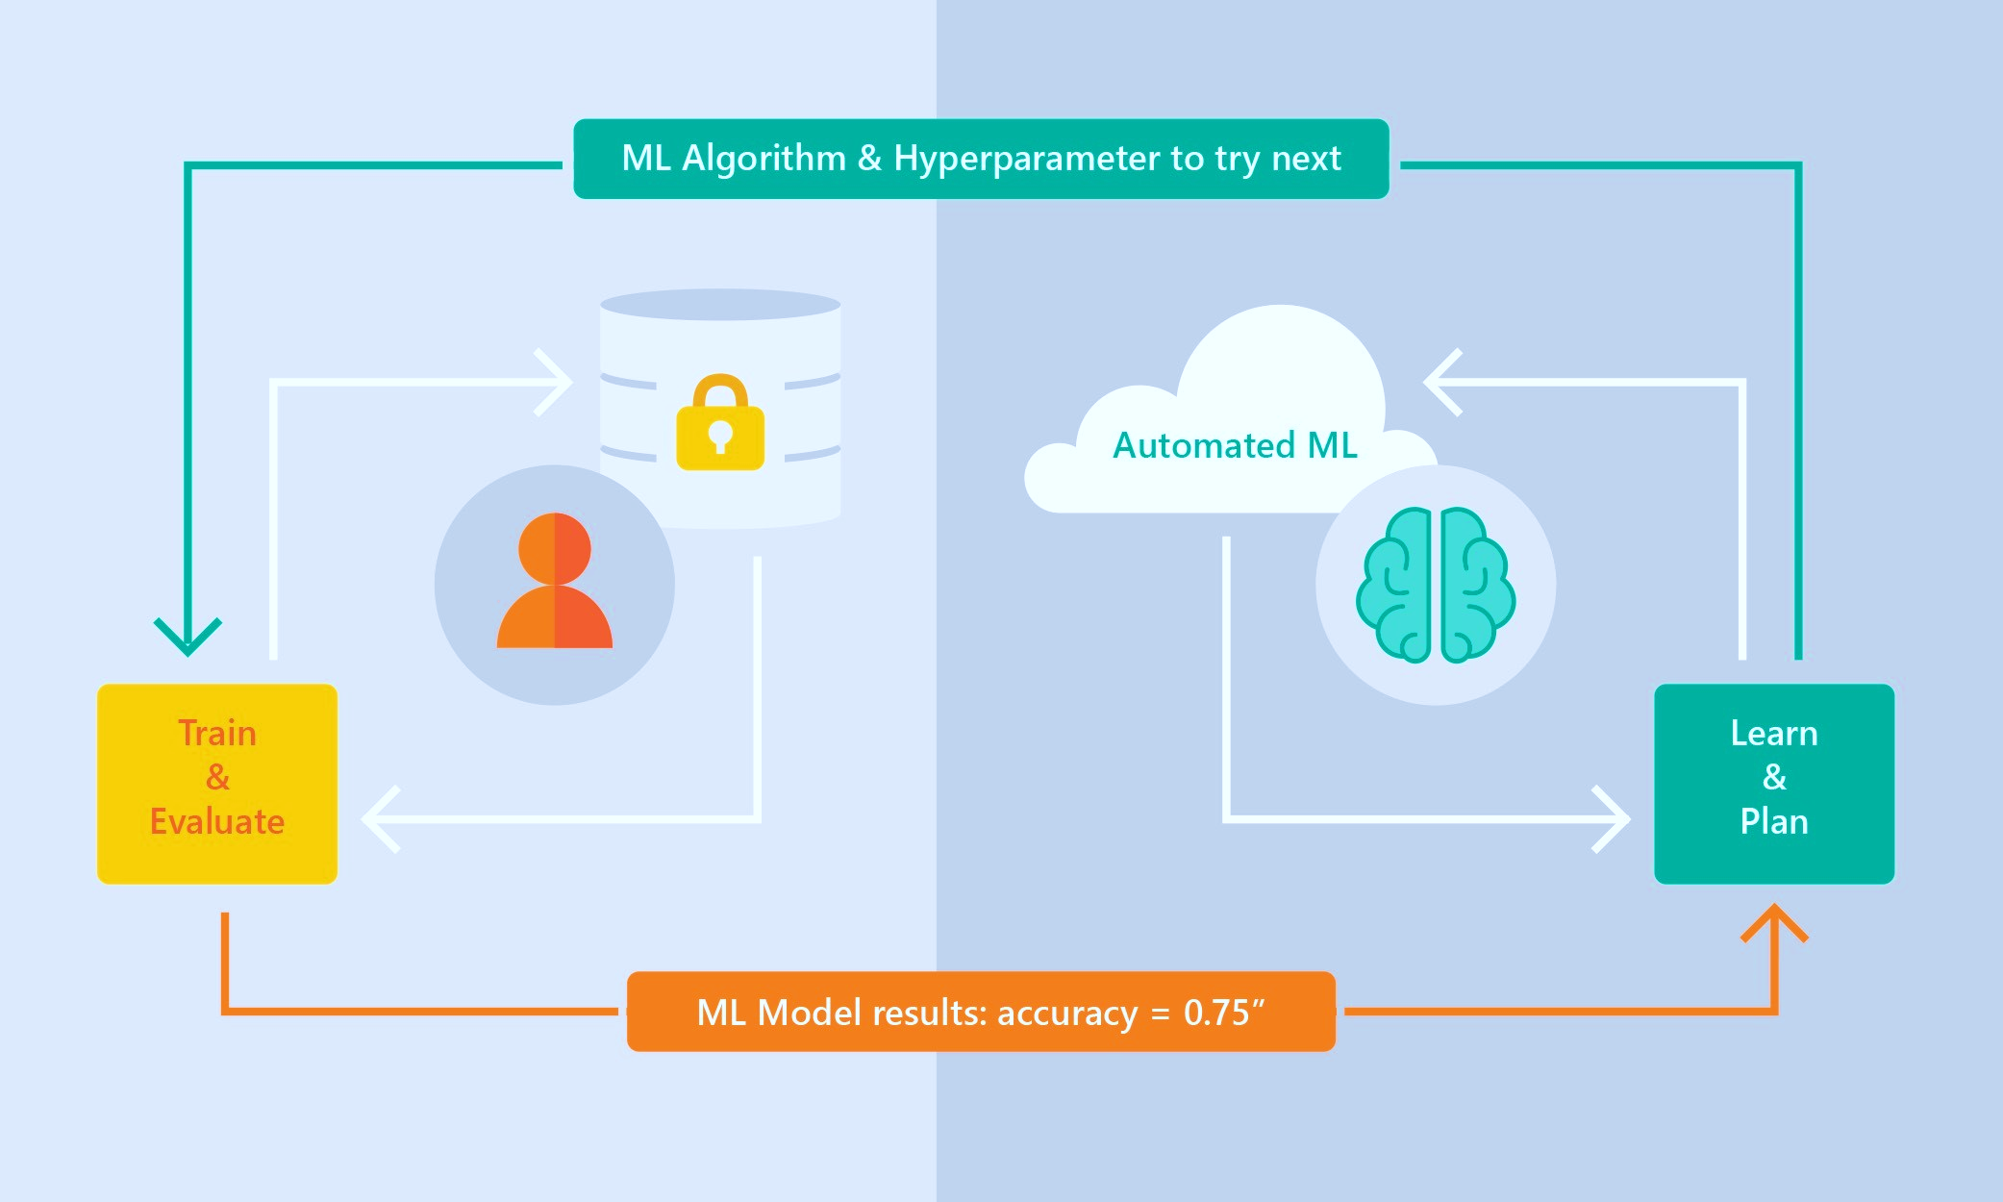
Automated ML Capabilities
Based on Microsoft Research
Brain trained with several million experiments
Collaborative filtering and Bayesian optimization
Privacy preserving: No need to “see” the data

Slide 26
Automated ML Capabilities
ML Scenarios: Classification & Regression
Integration: Azure Machine Learning, Azure Notebooks, Jupyter Notebooks
Data Type: Numeric, Text
Languages: Python SDK for deployment and hosting for inference
Training Compute: Local Machine, Remote Azure DSVM (Linux), Azure Batch AI
Transparency: View run history, model metrics
Scale: Faster model training using multiple cores and parallel experiments

Slide 27
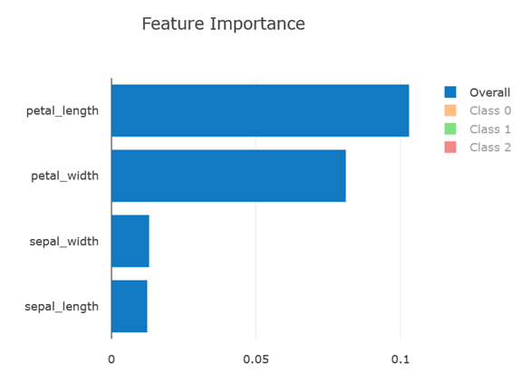
Model Explain-ability
GA:
Feature importance as part of training
Simple UX for feature importance for a selected iteration
Local feature importance for a given sample
Post GA:
Importance of Raw data columns
Accuracy and performance improvements

Slide 28
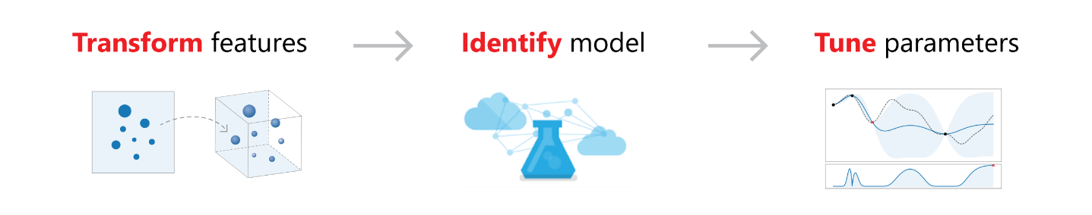
Feature Engineering
Dropping high cardinality or no variance features
Missing value imputation
Generating additional features
Transformations and encodings

Slide 29
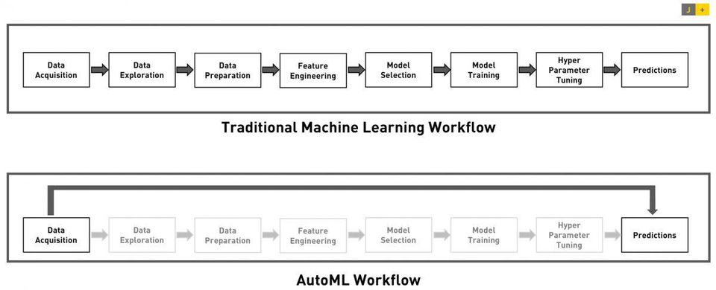
Automated ML Summary
Build Models Quickly and Easily
Transparency and control
Scale
Gain Insights

Slide 30
Support for Open source frameworks

Slide 31








Popular Frameworks
Use your favorite deep learning frameworks
without getting locked into one framework
TensorFlow
PyTorch
Scikit-Learn
ONNX
Community project created by Facebook and Microsoft
Use the best tool for the job. Train in one framework and transfer to another for inference
MXNet
Chainer
Keras
Notes:
Azure truly is the best place for Machine Learning
Most comprehensive set of pretrained services
Open & interoperable framework approach
Most comprehensive AI infrastructure with the lowest cost inferencing with FPGAs
The most flexible deployment options from cloud to the edge
It’s exciting. We should be able to win all Machine Learning engagements.
Now, let’s transition to the last solution area Knowledge Mining

Slide 32








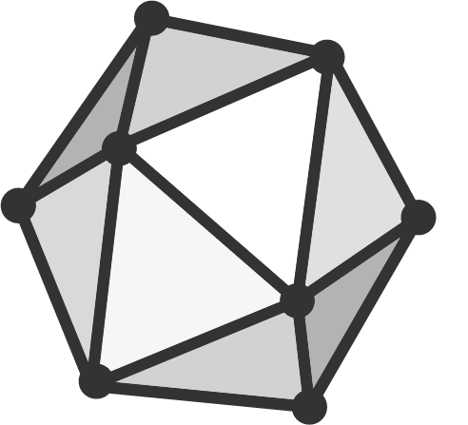





Create
Deploy
Frameworks
Azure
Azure Machine Learning services
Native support
Ubuntu VM
Native support
Windows Server 2019 VM
ML.NET
Windows Devices
Converters
ONNX Model
Services
Other Devices
(iOS, etc)
Native support
Converters
Azure Custom Vision Service

Slide 33
Deployment

Slide 34
Azure ML: How to deploy models at scale
Azure Machine Learning Service
Cognitive Services
Model Registry
Your IDE
Image Registry
Image Registry
Cloud Service
Azure Machine Learning Experimentation
Heavy Edge
Register Model
Scoring File
Create & Register Image
Deployment & Model Monitoring
Light Edge
External Model

Slide 35
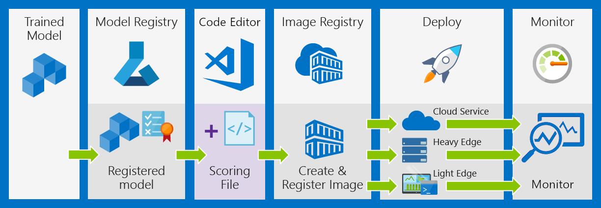
Deployment workflow
Notes:
Deploy models to Azure Kubernetes service with automatic scaling capability
Container-based hosting for improved time to market
Deploy models to the cloud, on-premises, to IoT edge and to FPGAs
Automatically optimize models to take advantage of new hardware accelerators in edge devices

Slide 36
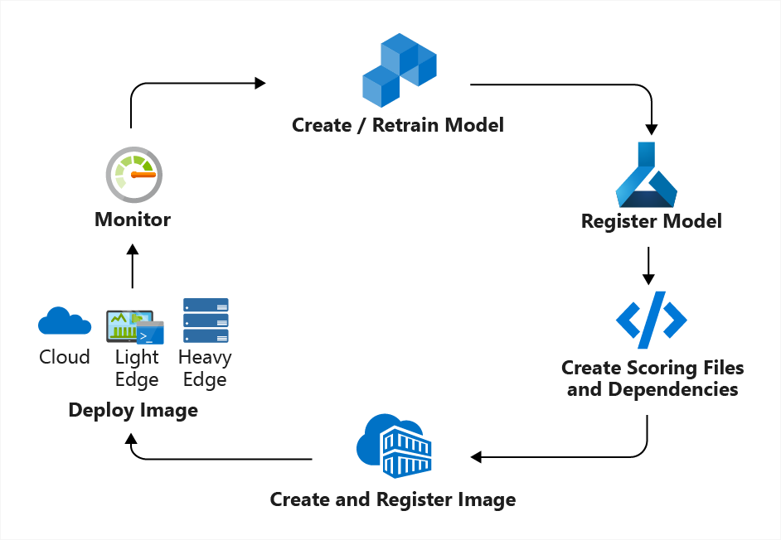
Deployment into a CI/CD workflow
Notes:
Deploy models to Azure Kubernetes service with automatic scaling capability
Container-based hosting for improved time to market
Deploy models to the cloud, on-premises, to IoT edge and to FPGAs
Automatically optimize models to take advantage of new hardware accelerators in edge devices

Slide 37
Deployment into a CI/CD workflow
Notes:
Deploy models to Azure Kubernetes service with automatic scaling capability
Container-based hosting for improved time to market
Deploy models to the cloud, on-premises, to IoT edge and to FPGAs
Automatically optimize models to take advantage of new hardware accelerators in edge devices

Slide 38
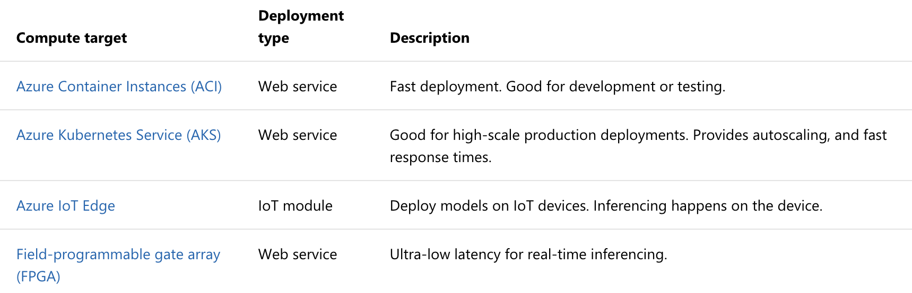
Deployments to Compute Targets
Notes:
Deploy models to Azure Kubernetes service with automatic scaling capability
Container-based hosting for improved time to market
Deploy models to the cloud, on-premises, to IoT edge and to FPGAs
Automatically optimize models to take advantage of new hardware accelerators in edge devices

Slide 39
Workshop/Demo – AML SDK
Azure Machine Learning with Azure Databricks https://aka.ms/aml-notebook-databricks-e2e Azure Notebooks https://notebooks.azure.com/azureml/projects/azureml-getting-started Azure ML Docs https://docs.microsoft.com/en-us/azure/machine-learning/service/
Notes:
Change the config based on params used in Databricks notebook.
Then upload config in tutorials folder.

Slide 40
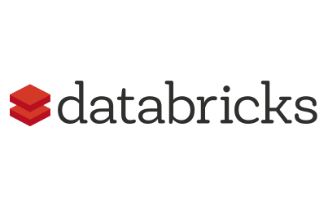







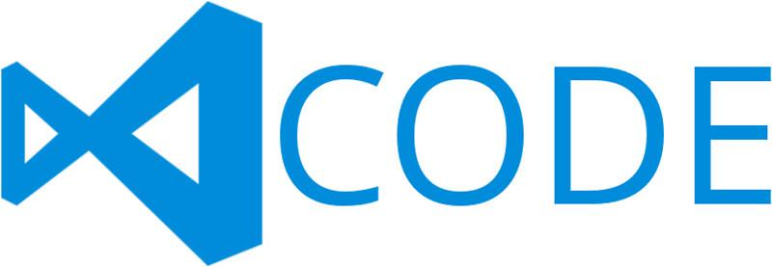

Azure Machine Learning SDK (summary)
Prepare
Experiment
Deploy
…
Prepare Data
Build model (your favorite IDE)
Train & Test Model (Manual or Automated)
Register and Manage Model
Build Image
Deploy A Scalable Service &
Monitor Model

Slide 41
Questions

